Slide 1
Lead Scoring Case Study using logistic regression
SUBMITTED BY :
Aniket Khodankar
Arshiya Begum
Palash Wanwani
Navneeth S

Slide 2
Contents
Problem statement
Problem approach
EDA
Correlations
Model Evaluation
Observations
Conclusion

Slide 3
Problem Statement
1. An education company named X Education sells online courses to industry professionals. On any given day, many professionals who are interested in the courses land on their website and browse for courses. They have process of form filling on their website after which the company that individual as a lead.
2. Once these leads are acquired, employees from the sales team start making calls, writing emails, etc. Through this process, some of the leads get converted while most do not.
3. The typical lead conversion rate at X education is around 30%. Now, this means if, say, they acquire 100 leads in a day, only about 30 of them are converted. To make this process more efficient, the company wishes to identify the most potential leads, also known as Hot Leads.
4. If they successfully identify this set of leads, the lead conversion rate should go up as the sales team will now be focusing more on communicating with the potential leads rather than making calls to everyone

Slide 4
Business Objective
1. Lead X wants us to build a model to give every lead a lead score between 0 -100 . So that they can identify the Hot leads and increase their conversion rate as well.
2. The CEO want to achieve a lead conversion rate of 80%.
3. They want the model to be able to handle future constraints as well like Peak time actions required, how to utilize full man power and after achieving target what should be the approaches.

Slide 5
Problem
Approach
Importing the data and inspecting the data frame
Data preparation
EDA
Dummy variable creation
Test-Train split
Feature scaling
Correlations
Model Building (RFE Rsquared VIF and p-values)
Model Evaluation
Making predictions on test set

Slide 6
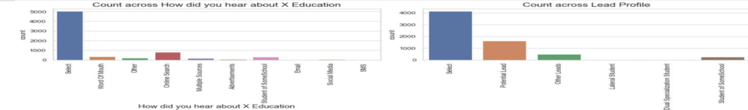
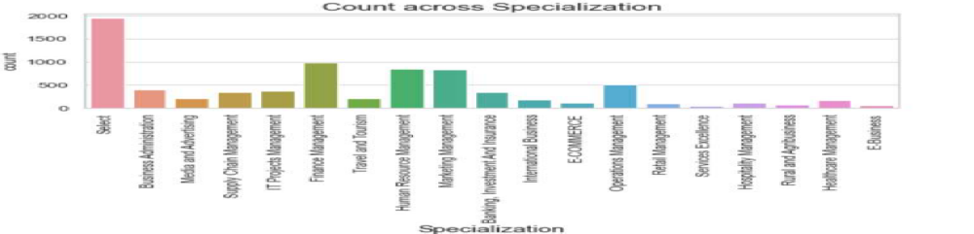
EDA – Data Cleaning
There are a few columns in which there is a level called 'Select' which is taking care

Slide 7
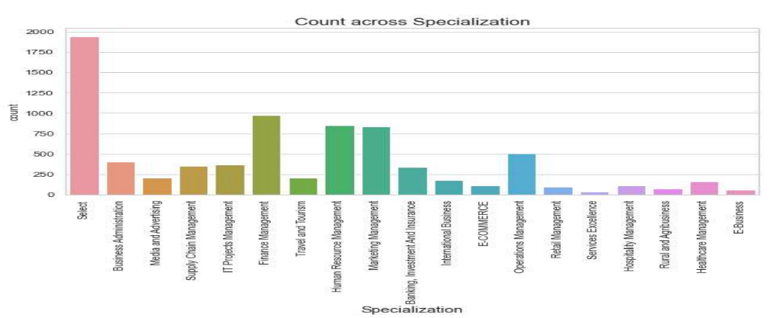
Specialization
Leads from HR, Finance & Marketing management specializations are high probability to convert

Slide 8
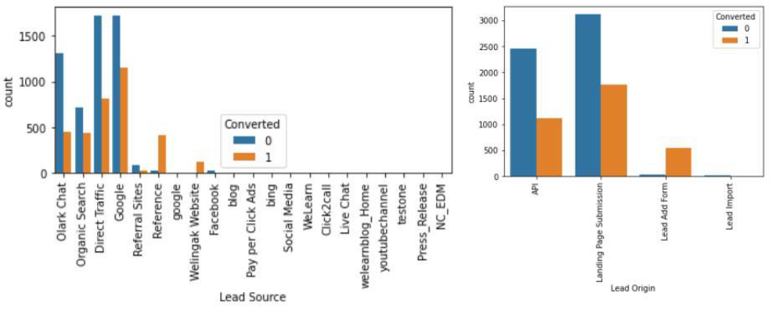
Lead Source & Lead origin
In lead source the leads through google & direct traffic high probability to convert
Whereas in Lead origin most number of leads are landing on submission

Slide 9
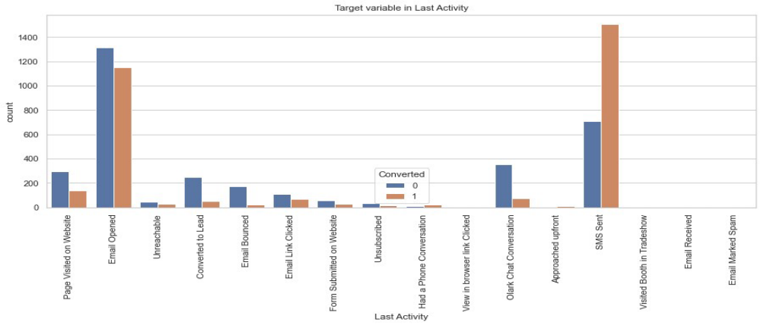
Last lead Activity
Leads which are opening email have high probability to convert, Same as
Sending SMS will also benefit.

Slide 10
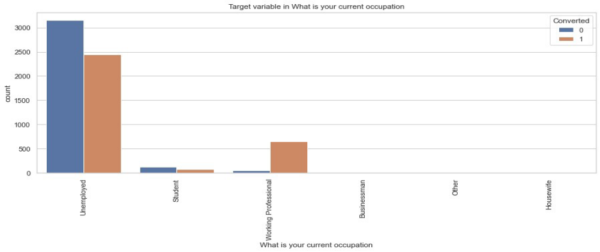
Last What is Your Occupation
Leads which are Unemployed are more interested to join the course than others.

Slide 11
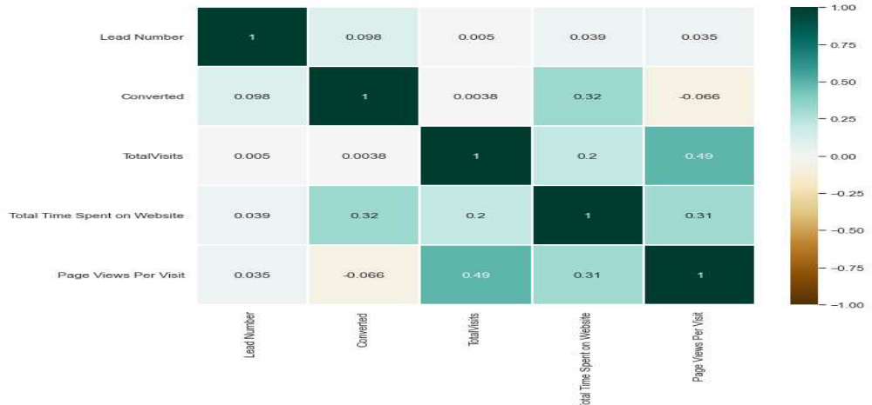
Correlation
There is no correlation between the variables

Slide 12
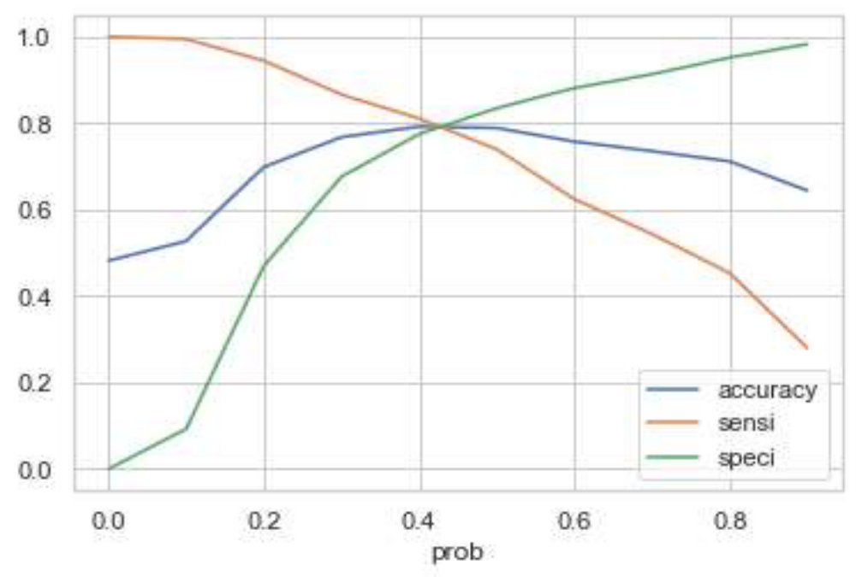
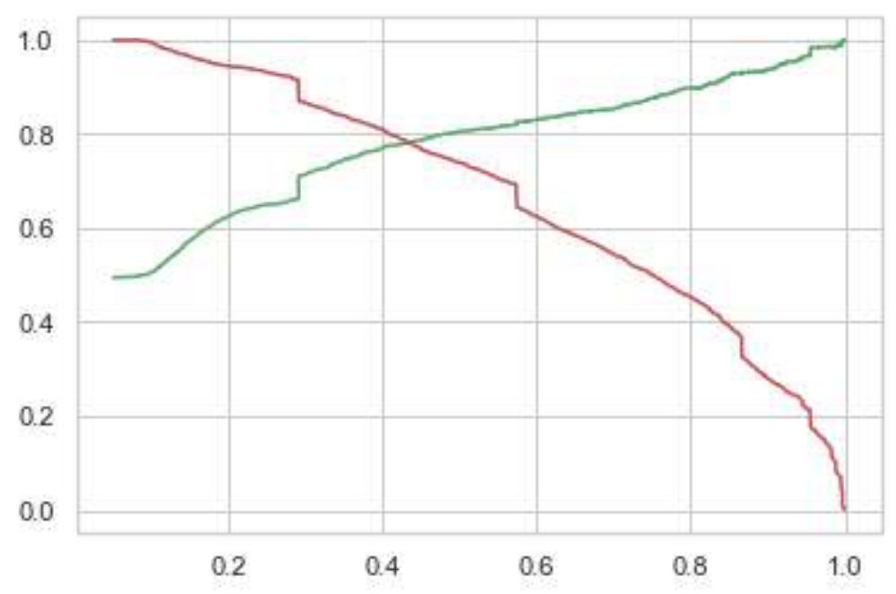
Model Evaluation
ROC curve
0.42 is the tradeoff between Precision and Recall -
Thus we can safely choose to consider any Prospect Lead with Conversion Probability higher than
42 % to be a hot Lead

Slide 13
Observations
Train Data:
Accuracy : 80%
Sensitivity : 77%
Specificity : 80%
Test Data:
Accuracy : 80%
Sensitivity : 77%
Specificity : 80%
Final Features list:
Lead Source_Olark Chat
Specialization_Others
Lead Origin_Lead Add Form
Lead Source_Welingak Website
Total Time Spent on Website
Lead Origin_Landing Page Submission
What is your current occupation_Working Professionals
Do Not Email

Slide 14
Conclusion
We see that the conversion rate is 30-35% (close to average) for API and Landing page submission. But very low for Lead Add form and Lead import. Therefore we can intervene that we need to focus more on the leads originated from API and Landing page submission.
We see max number of leads are generated by google / direct traffic. Max conversion ratio is by reference and welingak website.
Leads who spent more time on website, more likely to convert.
Most common last activity is email opened. highest rate = SMS Sent. Max are unemployed. Max conversion with working professional.

